Slide 1

Parallel-plate electric field measurement
Xian Ming-Zheng
2021/03/24
Department of earth and space science

Slide 2
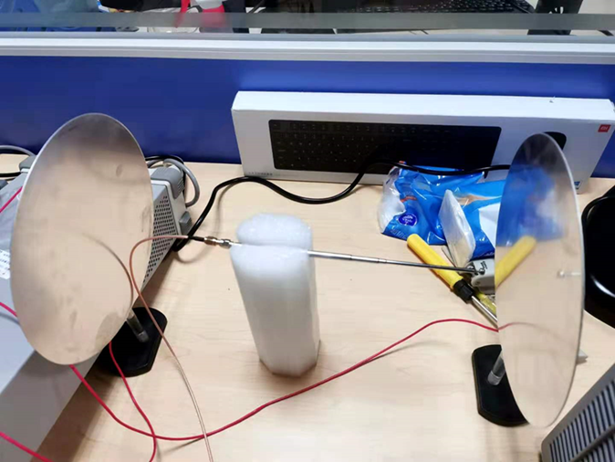
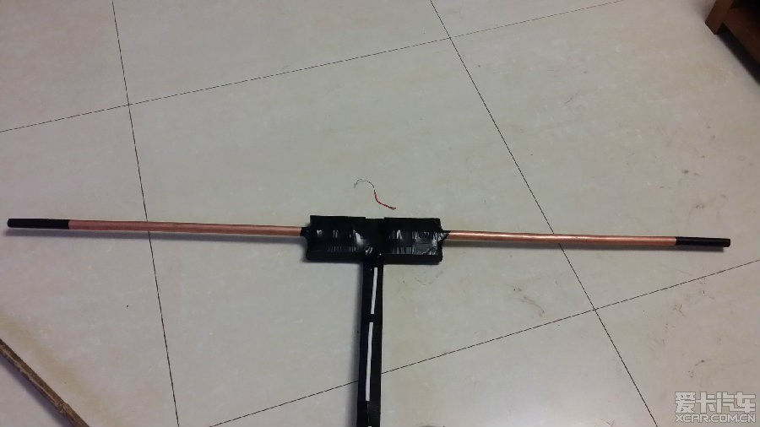
测量结果是否正确

Slide 3


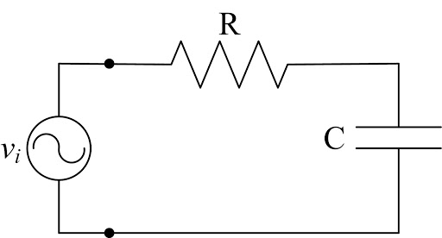
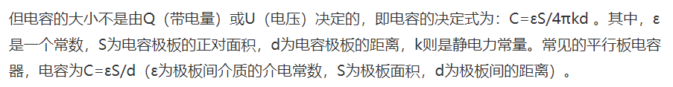


$$U_{i}=\tilde{U}=U∗\sin{(ωt)}$$
$$Z=1/{jωC}$$
$$U_{o}=U_{i}∗Z/{(R+Z)}$$
$$U_{O}=U_{i∗}{ (1−jωRC)}/{[1+{(ωRC}^{)2}]}$$
$$U_{O}=\frac{U_{i}}{1+{(ωRC)}^{2}}\left|1−jωRC\right|e^{∠φ}$$
$$U_{O}=\frac{U_{i}}{（1+{(ωRC^2))}^{1/2}}e^{∠φ}$$
$$R=1000ΚΩ$$
$$C=10nF$$
$$U=20V_{pp}={(\frac{20}{\sqrt{2}})V}_{rms}$$
$$τ=\frac{1}{RC}=1S$$
wire resistance ???
$$\frac{ε_{r}s}{4πkd}$$
$$k=8.987551×10^9N·m^2/C^2$$

Slide 4
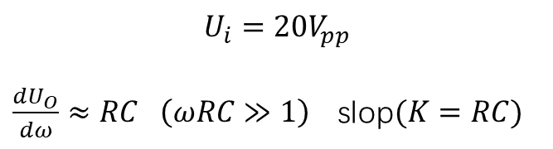




$$U_{i}=20V_{pp}$$
$\frac{{dU}_{O}}{dω}≈RC \left(ωRC≫1\right)$slop$(K=RC)$
$$U_{O}=\frac{U_{i}}{（1+{(ωRC^2))}^{1/2}}e^{∠φ}$$
$$U_{O}=\frac{U_{i}}{（{(ωRC^2))}^{1/2}}e^{∠φ}$$
$$U_{O}=\frac{U_{i}}{（{(ωRC^2))}^{1/2}}e^{∠φ}$$
$$U_{O}=\frac{U_{i}}{（1+{(ωRC^2))}^{1/2}}e^{∠φ}$$

Slide 5
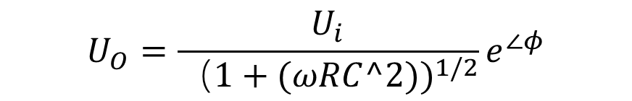
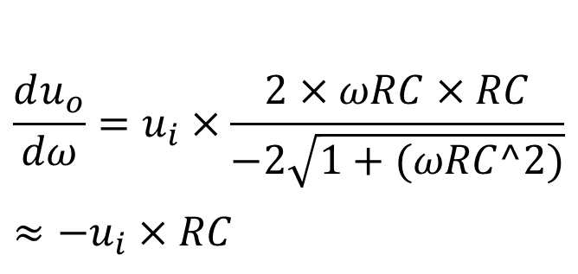
$$U_{O}=\frac{U_{i}}{（1+{(ωRC^2))}^{1/2}}e^{∠φ}$$
$$\frac{du_{o}}{dω}=u_{i}×\frac{2×ωRC×RC}{−2\sqrt{1+(ωRC^2)}}≈{−u}_{i}×RC$$

Slide 6
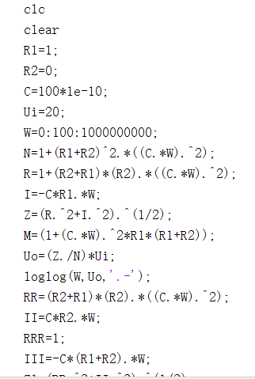
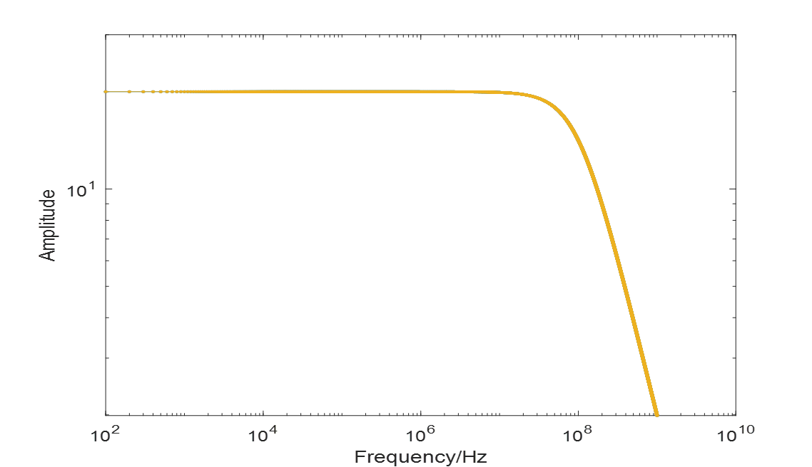
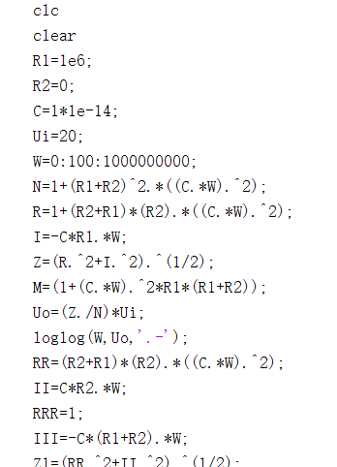


$$R=1$$
$$C=10^−8$$
$$R=10^6$$
$$C=10^−14$$

Slide 7
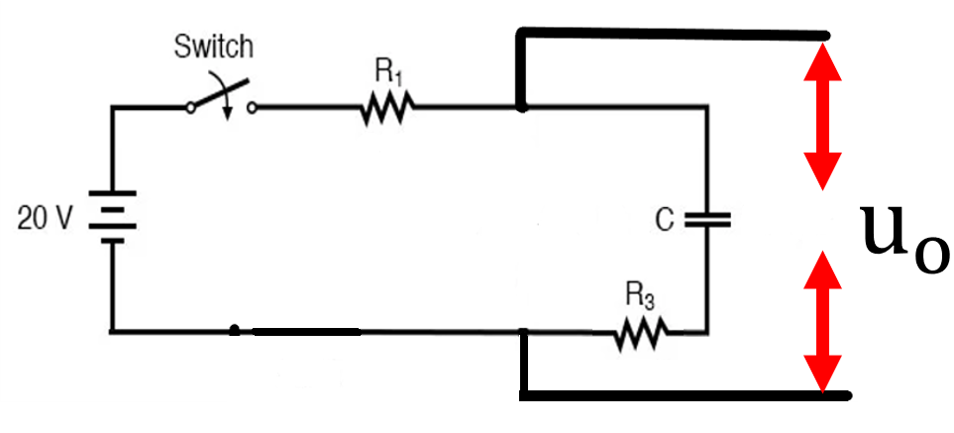
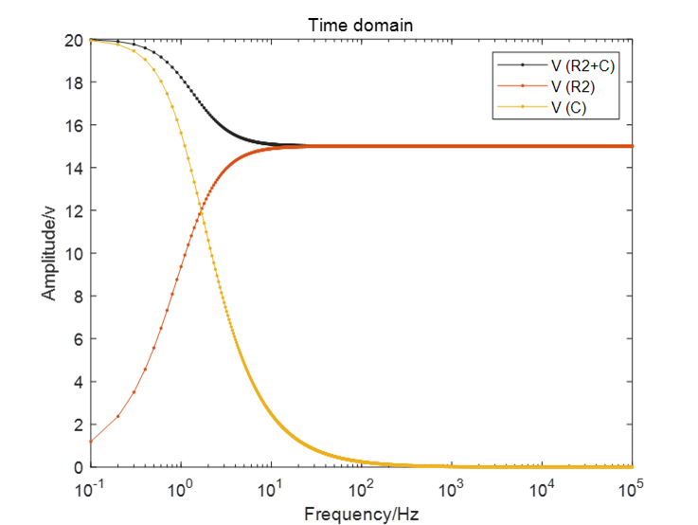
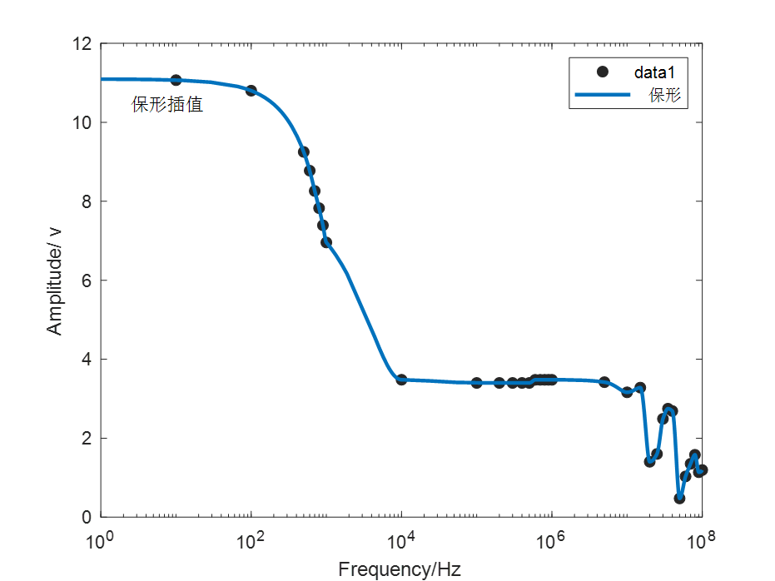
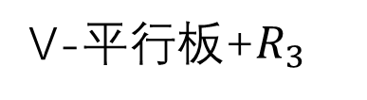
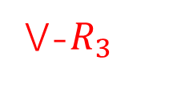
V-平行板+$R_{3}$
V-$R_{3}$
V-平行板

Slide 8
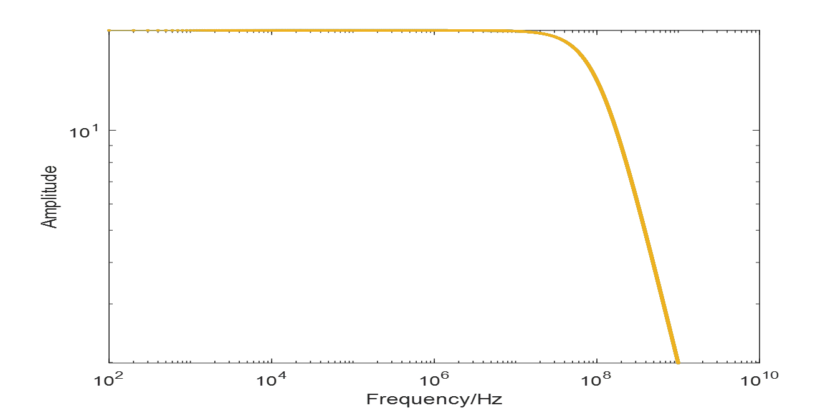
Max output frequency ：250MHz
Signal source problem ???

Slide 9
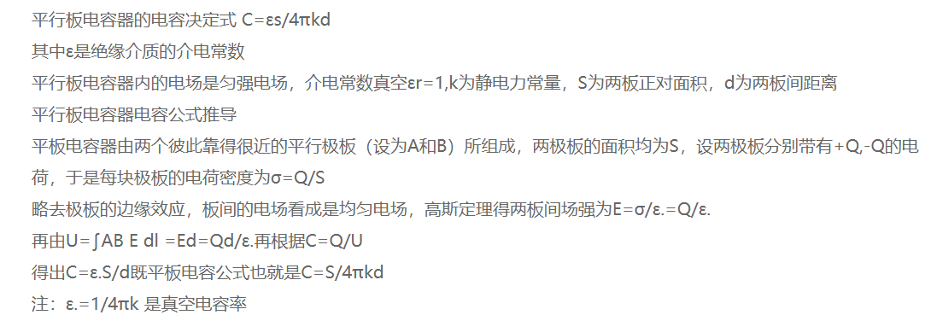

$$ε_{0}=9∗{10}^{−12}{ ε}_{r}=1$$
$$r=0.1m$$
$$d=1m$$
$$R_{\text{resistance} }≈1∗{10}^{6} Ω$$

Slide 10
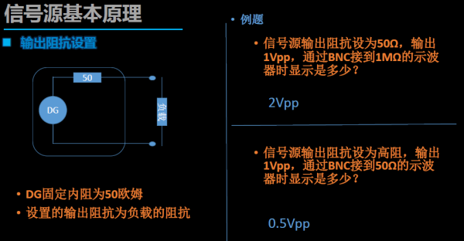
Differential coefficient
信号发生器内阻

Slide 11
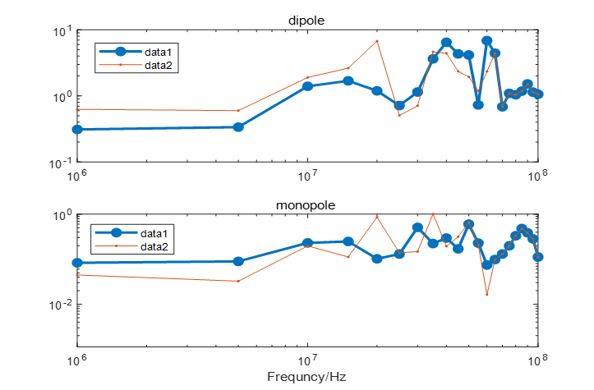

Slide 12
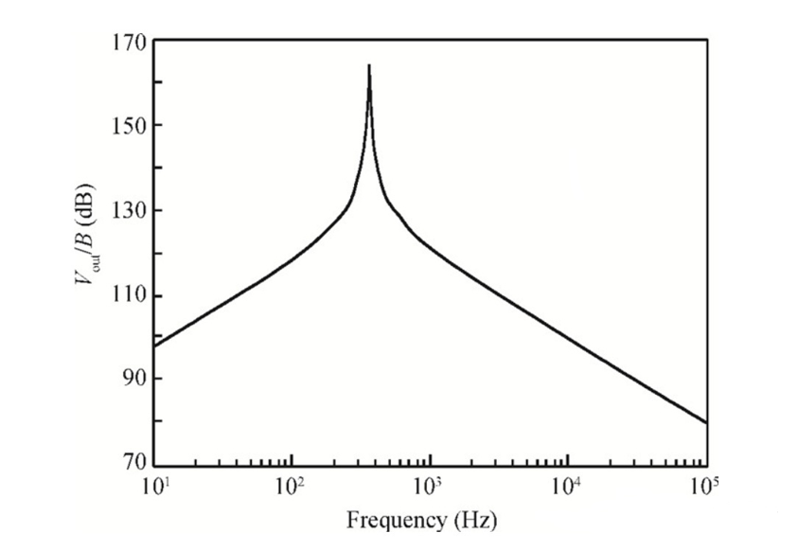

$$L=\frac{λ}{2}$$
$$f=\frac{C}{λ}$$
$$f=\frac{C}{2∙L}$$
$$L=2m$$
$$f=75MHz$$

Slide 13
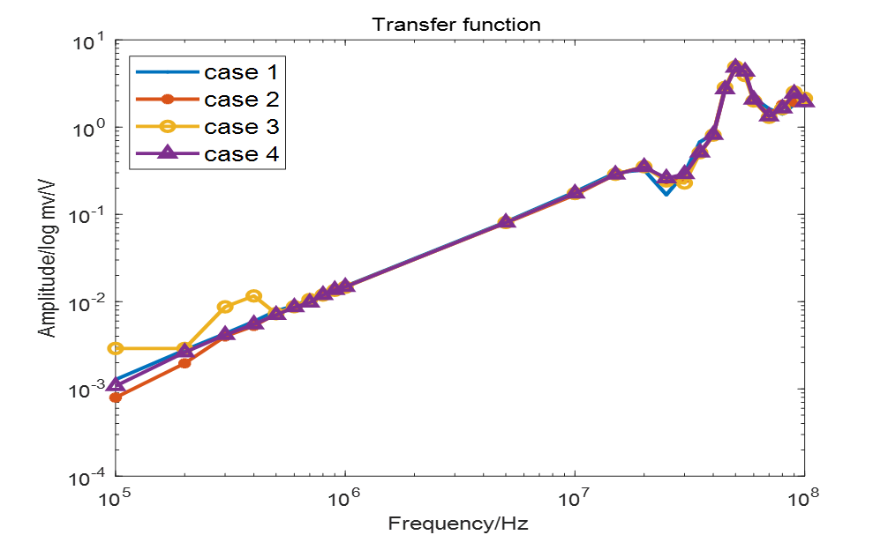





Monopole response
$$50MHz$$
$$≤250MHz$$
$$≤250MHz$$
$$40MHz$$
$$40MHz$$

Slide 14
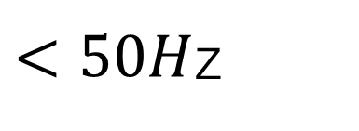
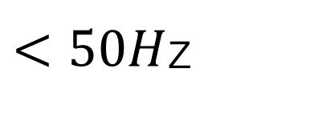
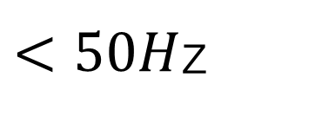
$<50H$z
$<50H$z
$<50H$z

Slide 16
Square wave response function

Slide 17
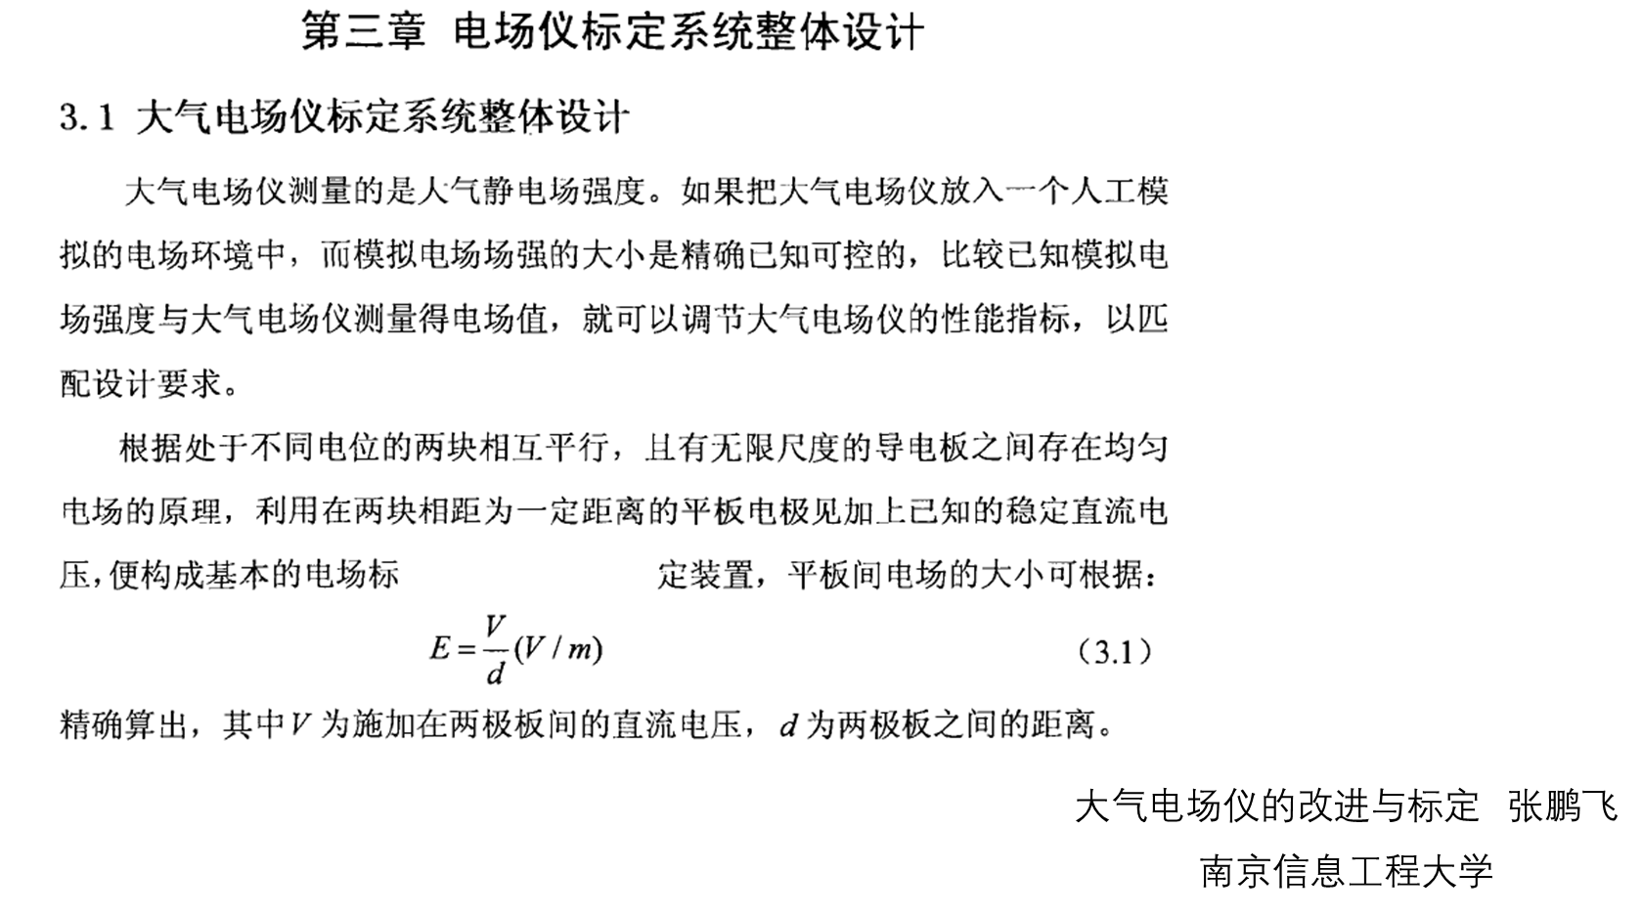
The voltage on the board will be greater than the set voltage
For example, the voltage on the board is 42.36V when it is 10M, but the voltage is set to 20V
The antenna induced potential will be greater than the potential of the two plates
Whether it is necessary to shield external electromagnetic signals
To Increase the area of the plate S
The external 50Hz signal is stronger

Slide 18
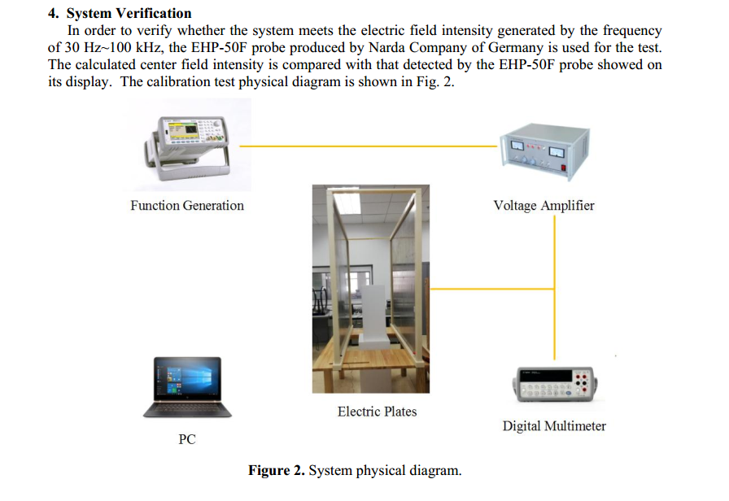
J Zuo, Zheng X . Research on Calibration System of Low Frequency Electric Field Measuring Instrument[J]. 2020.

